Slide 1
Building Responsive UI with Bootstrap
Jon Galloway | Technical Evangelist
Christopher Harrison | Content Developer

Slide 2


Course Topics
Building Responsive UI with Bootstrap
01 | Introduction to Bootstrap | 05 | Bootstrap and JavaScript
02 | Bootstrap Components | 06 | Using Bootstrap with LESS
03 | Page Design | 07 | Bootstrap in the Real World
04 | Visual Studio and ASP.NET Integration | 08 | Supplement Your Knowledge

Slide 3
01 | Introduction to Bootstrap
Jon Galloway | Technical Evangelist
Christopher Harrison | Content Developer

Slide 4
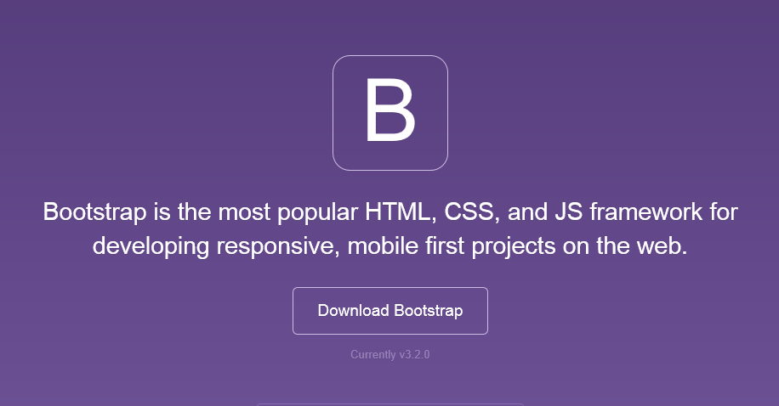
Bootstrap
The most popular front-end framework for developing responsive, mobile first projects on the web.

Slide 5
Why use it?
CSS is can be tricky
Cross browser support can be a challenge
Solves basic tasks (e.g. page layout without tables)
Bootstrap 3 makes it easier

Slide 6
Bootstrap Features
Theme Support
Responsive
Grid
Components
Pagination
Buttons
Modal
Great Visual Studio support

Slide 7





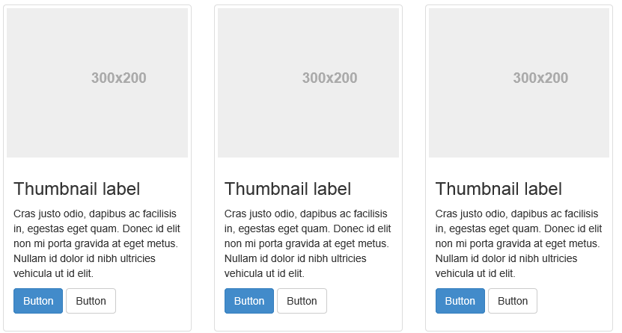
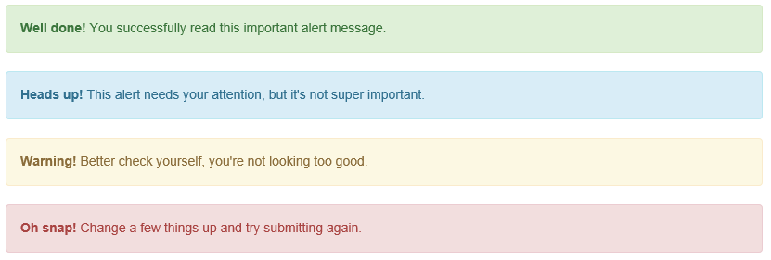
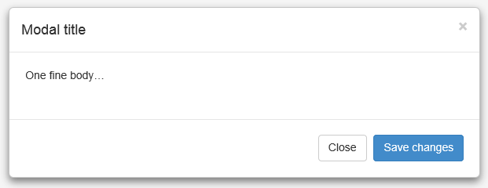
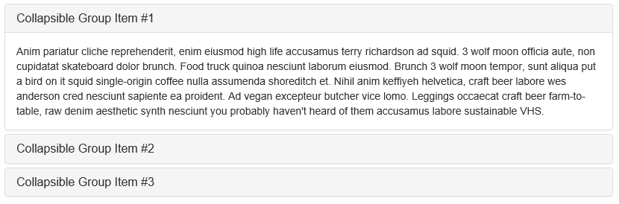
Components

Slide 8
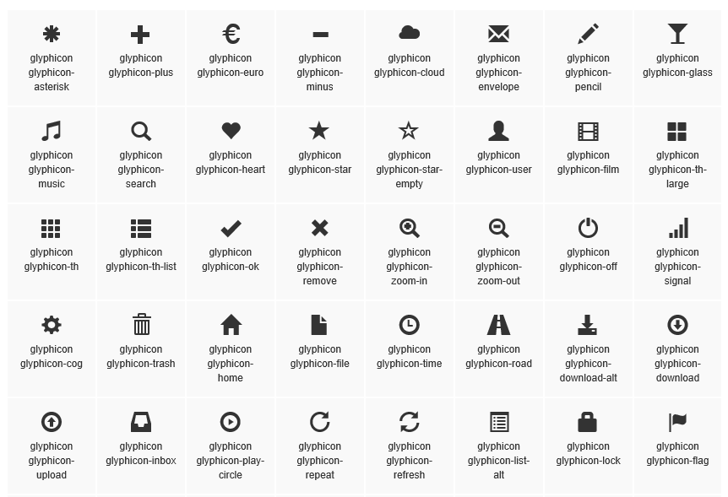
Glyphicons

Slide 9
A quick lap around Bootstrap

Slide 10
Theme Support

Slide 11
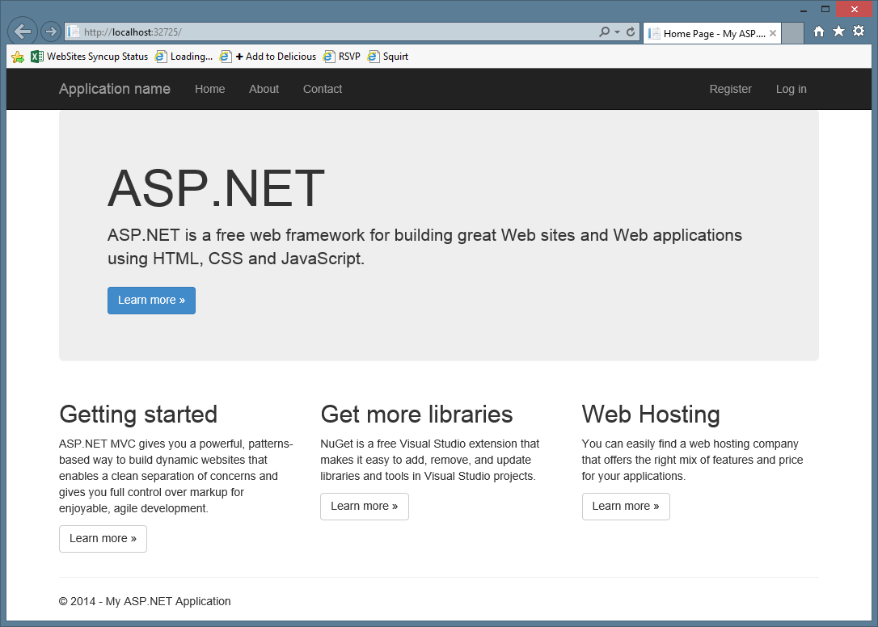

Slide 12
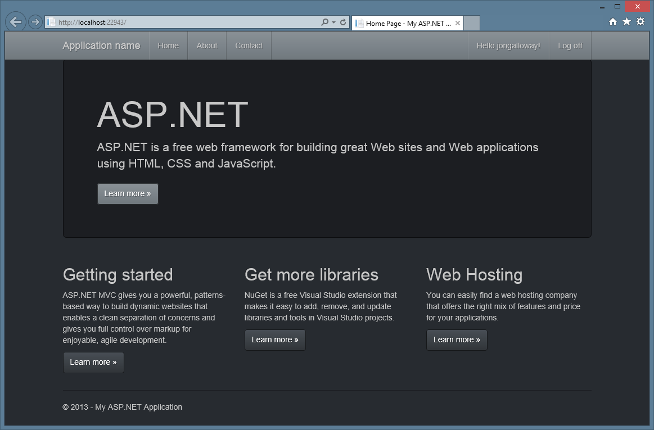

Slide 13
Bootstrap themes

Slide 14
Responsive Layout
Notes:
Bootswatch

Slide 15
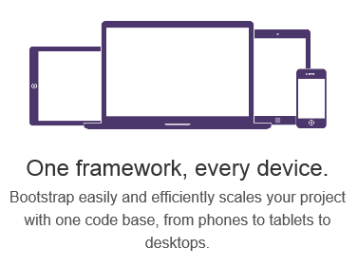
Responsive Layout

Slide 16
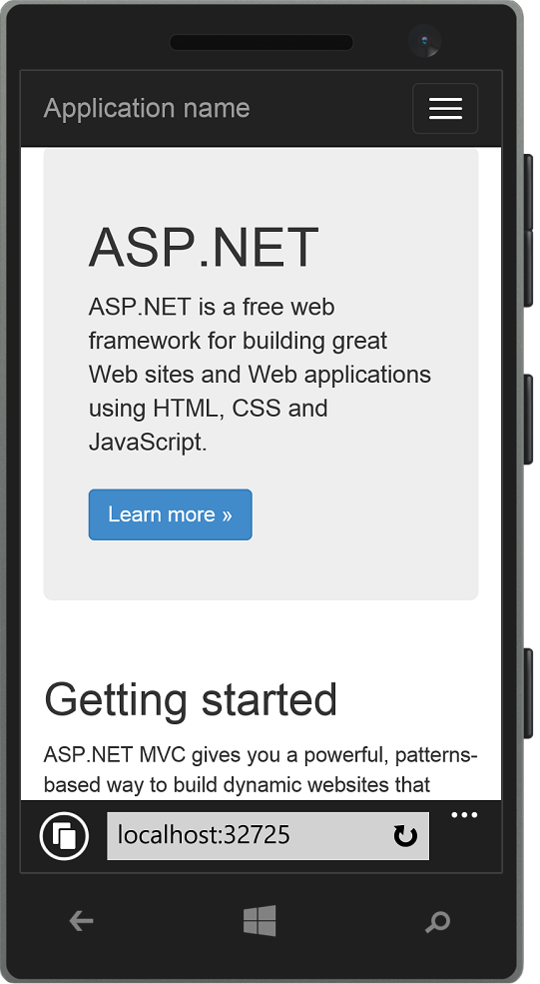
Responsive Layout

Slide 17
Bootstrap - Responsive
Notes:
Show page responding to screen width changes
Show page in mobile browser
Emphasize that this is just HTML and CSS – no server or JS code

Slide 18
Grid System

Slide 19
Grid system
 | Extra small devices Phones (<768px) | Small devices Tablets (≥768px) | Medium devices Desktops (≥992px) | Large devices Desktops (≥1200px)
Grid behavior | Horizontal at all times | Collapsed to start, horizontal above breakpoints
Container width | None (auto) | 750px | 970px | 1170px
Class prefix | .col-xs- | .col-sm- | .col-md- | .col-lg-
# of columns | 12
Column width | Auto | 60px | 78px | 95px
Gutter width | 30px (15px on each side of a column)

Slide 20
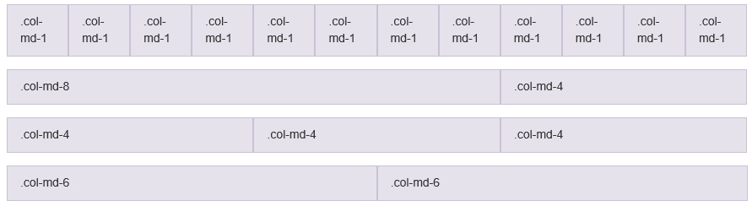
Grid system

Slide 21
Bootstrap - Grid
Notes:
Christopher - Grid

Slide 22
Visual Studio support

Slide 23
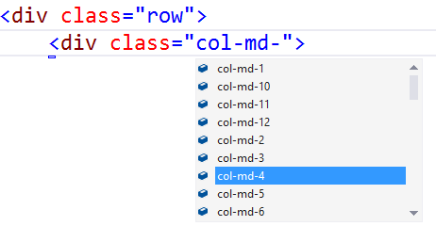
Visual Studio – Class IntelliSense

Slide 24
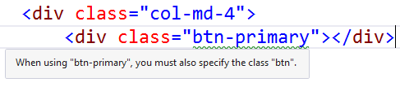
Visual Studio – Missing Class Detection

Slide 25
Bootstrap – Visual Studio Support

